Slide 1
Git Workflow Overview
Actually actually getting stuff done ;)
Summer 2021
Notes:
1
1
Check distro statement before using:
DISTRIBUTION STATEMENT A. Approved for pubic release: distribution is unlimited.
This material is based upon work supported under Air Force Contract No. FA8721-05-C-0002 and/or FA8702-15-D-0001. Any opinions, findings, conclusions or recommendations expressed in this material are those of the author(s) and do not necessarily reflect the views of the U.S. Air Force.
© 2021 Massachusetts Institute of Technology.
Delivered to the U.S. Government with Unlimited Rights, as defined in DFARS Part 252.227-7013 or 7014 (Feb 2014). Notwithstanding any copyright notice, U.S. Government rights in this work are defined by DFARS 252.227-7013 or DFARS 252.227-7014 as detailed above. Use of this work other than as specifically authorized by the U.S. Government may violate any copyrights that exist in this work.

Slide 2
At this point…
You’ve set up your SSH keys
You’ve cloned your team’s repo to your computer
You’ve gotten your dev environment set up

Slide 3
At this point…
You’ve set up your SSH keys
You’ve cloned your team’s repo to your computer
You’ve gotten your conda environment set up
Now we will be starting with Git

Slide 4
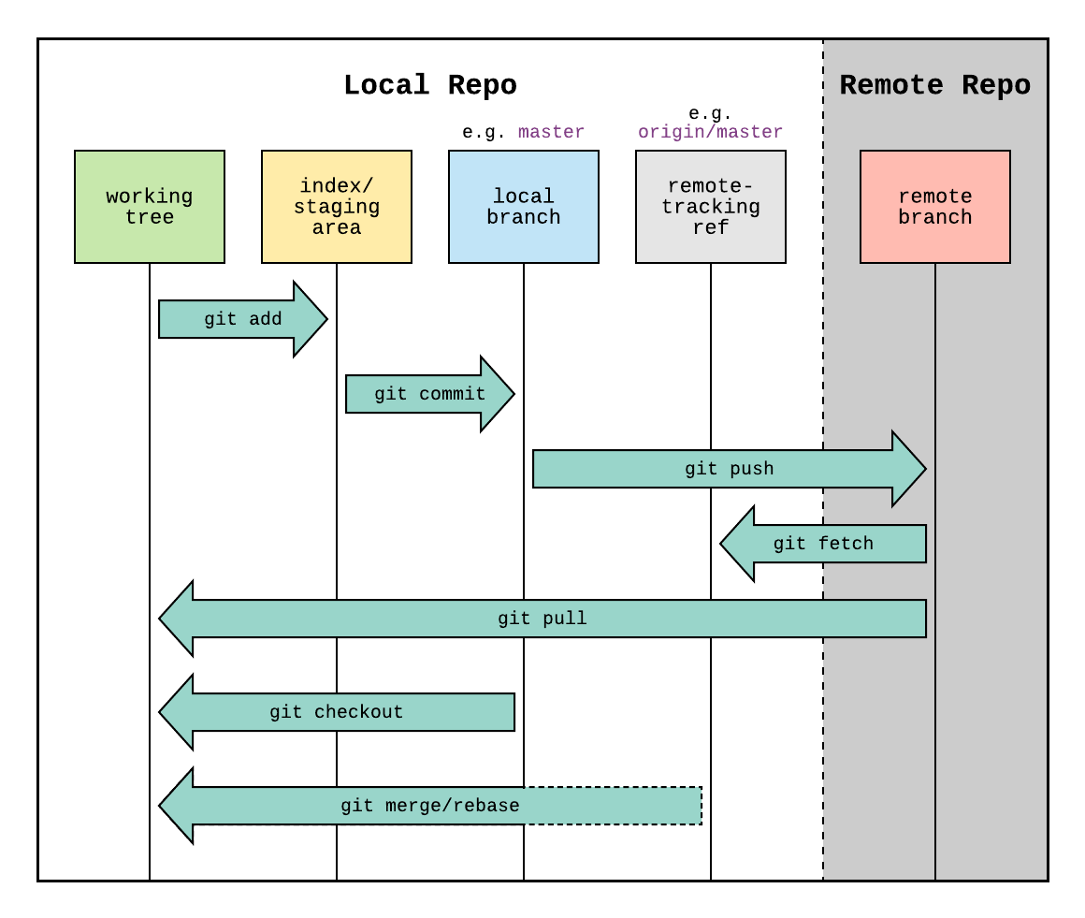
Git Structure at a Glance

Slide 5
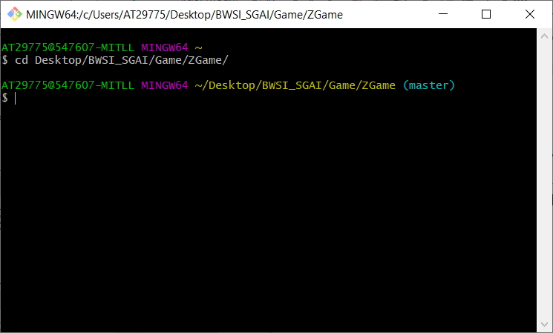
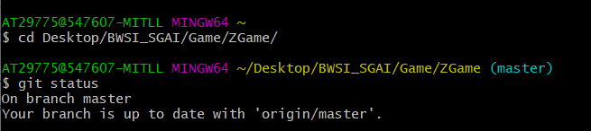
Starting off
Go to the directory of your local repository.
If your are on Git Bash (Windows), you will see the term master when you are in the folder of the repo. Otherwise, you can run git status

Slide 6
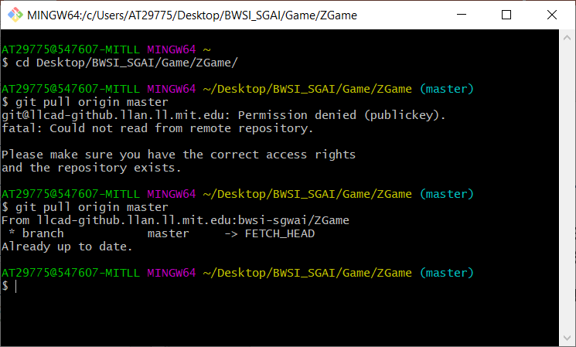
Pulling
Before making any changes, check you are up-to-date with the latest version on the remote repository (check GitHub).
Update to calling git pull origin master
This is good, not always the case

Slide 7
Remember the #1 DON’T?
Best practices: DON’T commit to master
To go to a separate branch, call git checkout –b [name of branch]
The –b keyword creates a new branch in your local repo, so you only need to include that once per branch
If you want to switch to a different existing branch, just call git checkout [name of branch]
Committing on master is a recipe for disaster

Slide 8
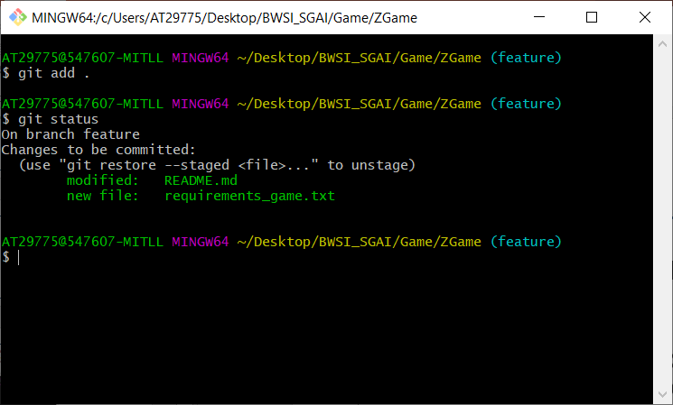
Make some edits…
Remember, a few small edits at a time
Not an entire feature
How to we keep track of the changes as we go along on a branch? git add git reset git commit
Notes:
Make some edits to the README.md at this time

Slide 9
… Stage the changes
Remember, a few small edits at a time
Not an entire feature
How to we keep track of the changes as we go along on a branch? git add git reset git commit
Notes:
Make some edits to the README.md at this time

Slide 10
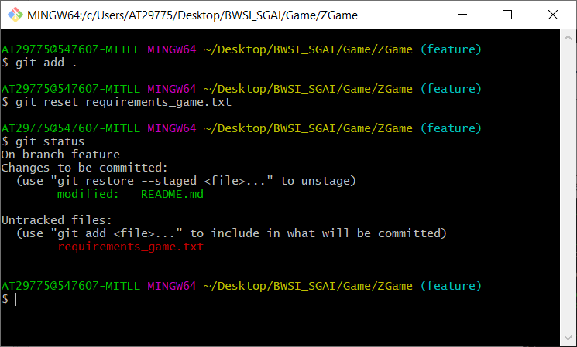
… Unstage irrelevant stuff
Remember, a few small edits at a time
Not an entire feature
How to we keep track of the changes as we go along on a branch? git add git reset git commit
Notes:
Make some edits to the README.md at this time

Slide 11
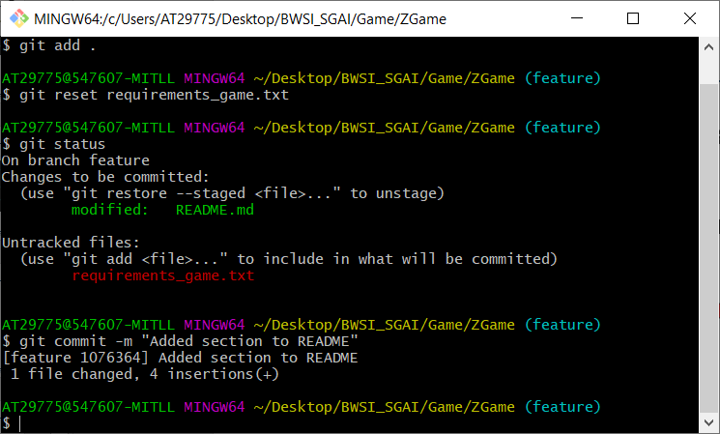
…And commit!
Remember, a few small edits at a time
Not an entire feature
How to we keep track of the changes as we go along on a branch? git add git reset git commit
Remember your commit messages!
Notes:
Make some edits to the README.md at this time

Slide 12
Progress
What’s the next step?

Slide 13
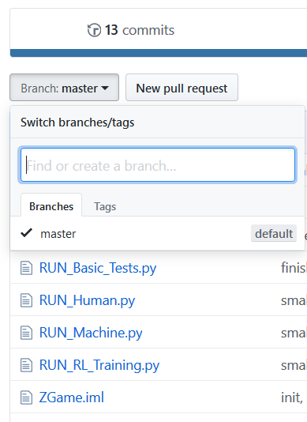
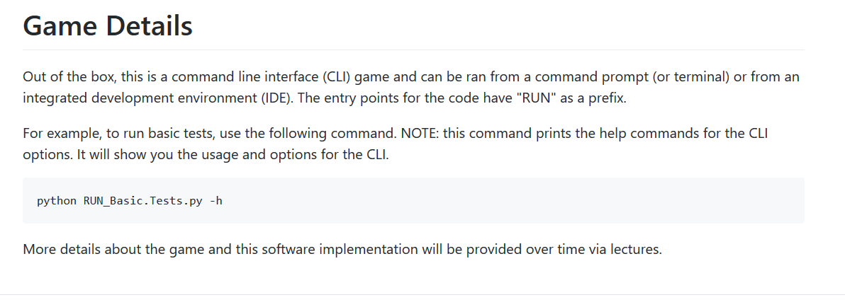
Did It Work?

Slide 14
Did It Work?
COMMIT != PUSH

Slide 15
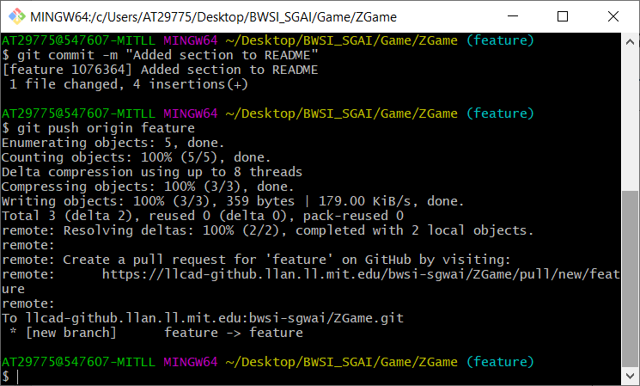
Let’s Push
Make a call to git push origin feature
Again, don’t push to master directly
The remote branch is automatically created if not already there

Slide 16
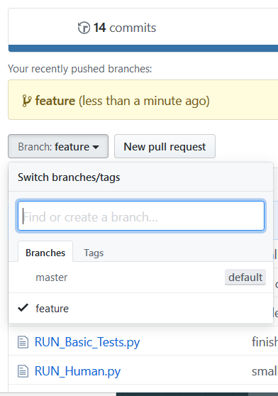
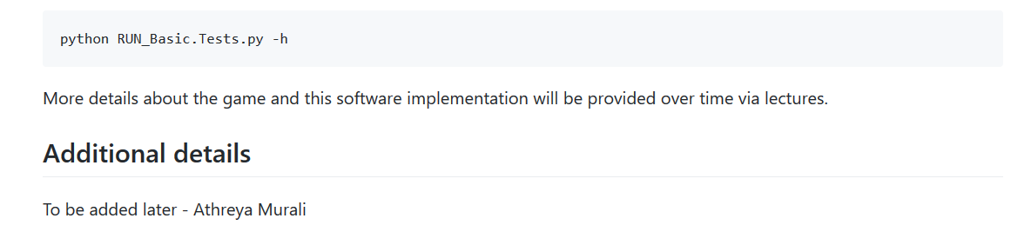
Now It Works

Slide 17
Conflict Resolution
Aaand we’re live!

Slide 18
When might a conflict occur?
Two people are pushing commits to the same branch that affect the same code
Pulling from a branch that someone else pushed
Not necessarily simultaneous

Slide 19
Issues, Milestones, and Projects, Oh My!
Project Management on GitHub

Slide 20
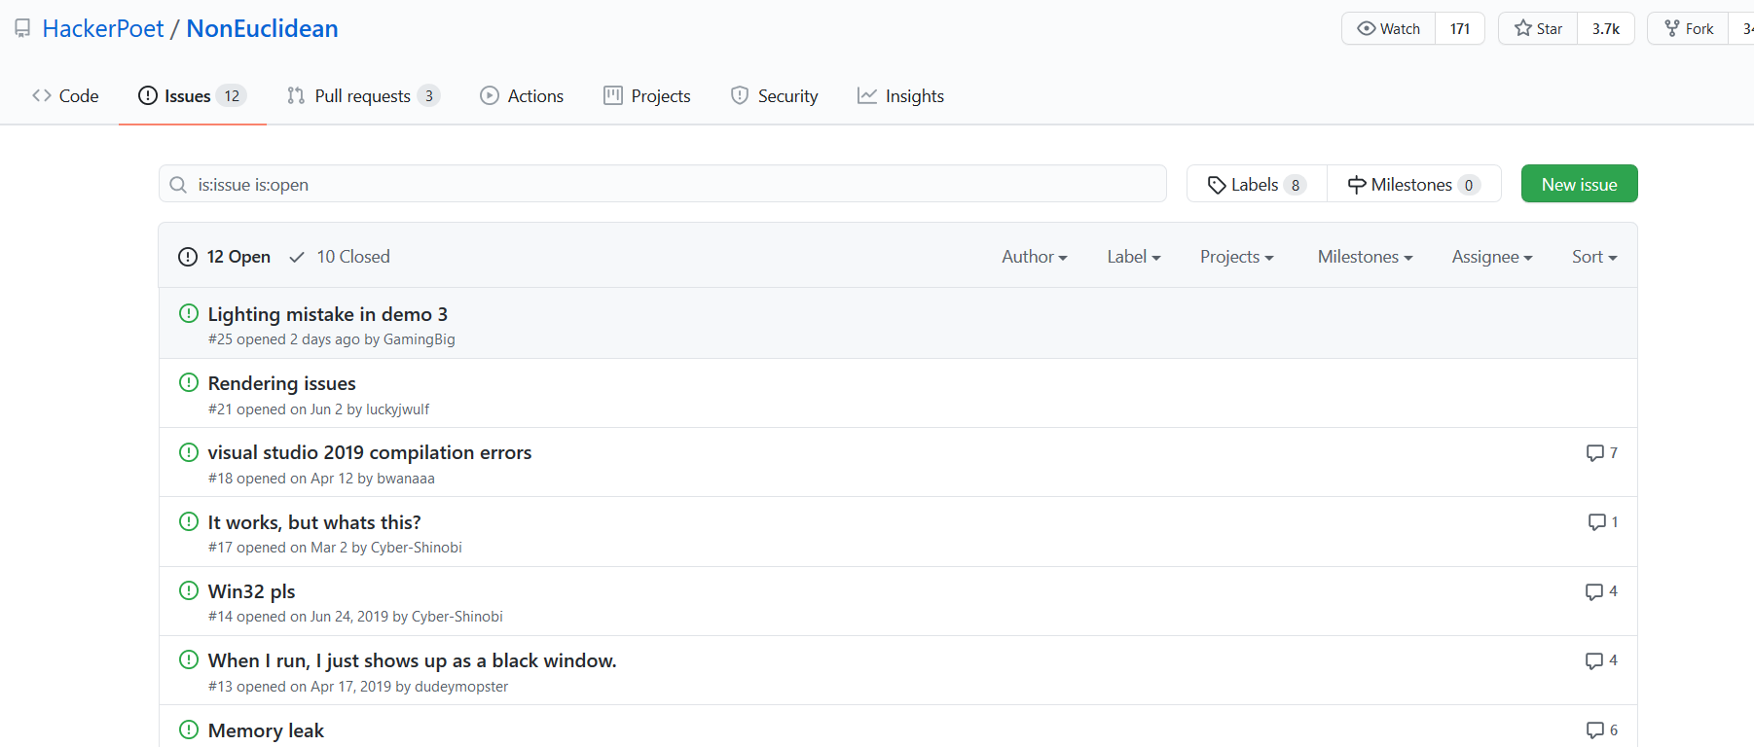
Issues
Used to “keep track of tasks, enhancements, and bugs”
MUCH better than scrolling thru a bunch of emails or screenshots on Discord

Slide 21
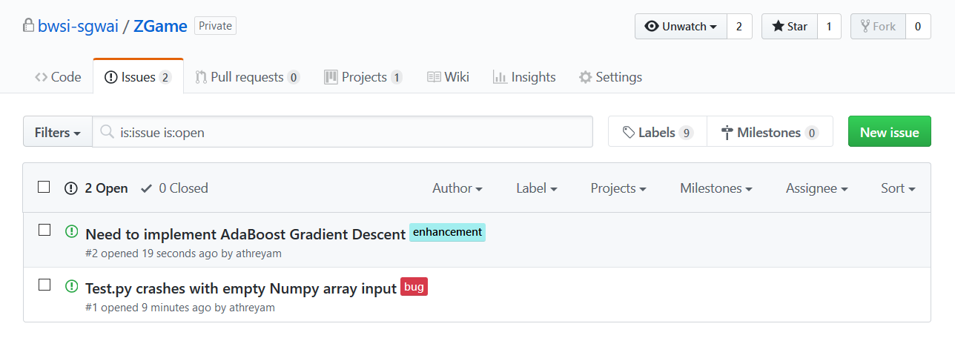
Labelling Issues
Issues can have labels to help identify and filter them
As issues are added, this can be useful for organizational purposes

Slide 22
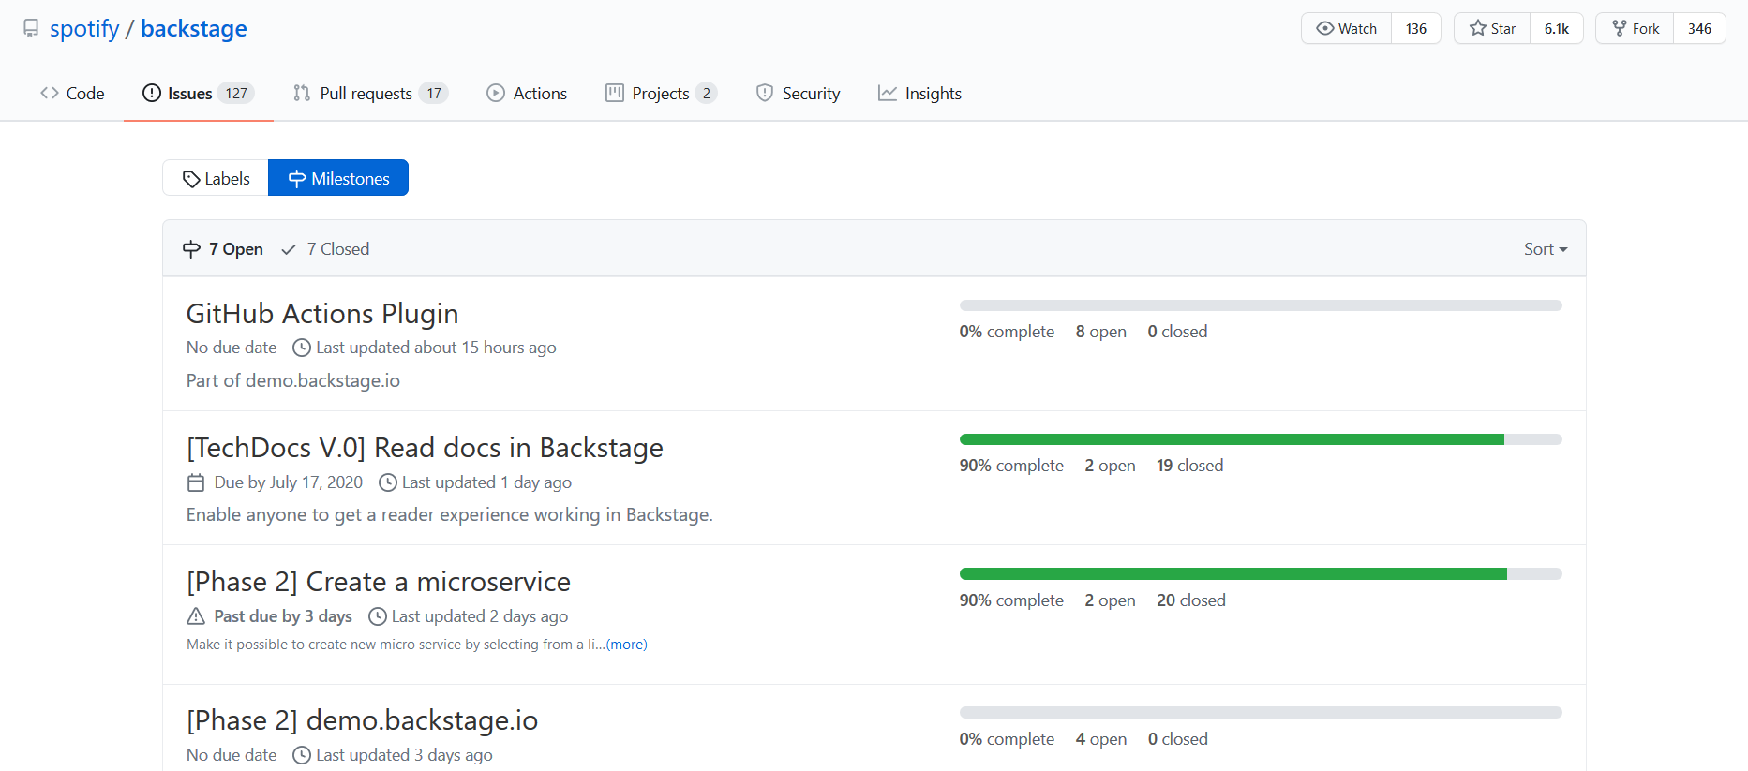
Milestones
A method of tracking progress for time-sensitive deadlines and sprints
Similar to issue labels but groups issues and pull requests by category

Slide 23
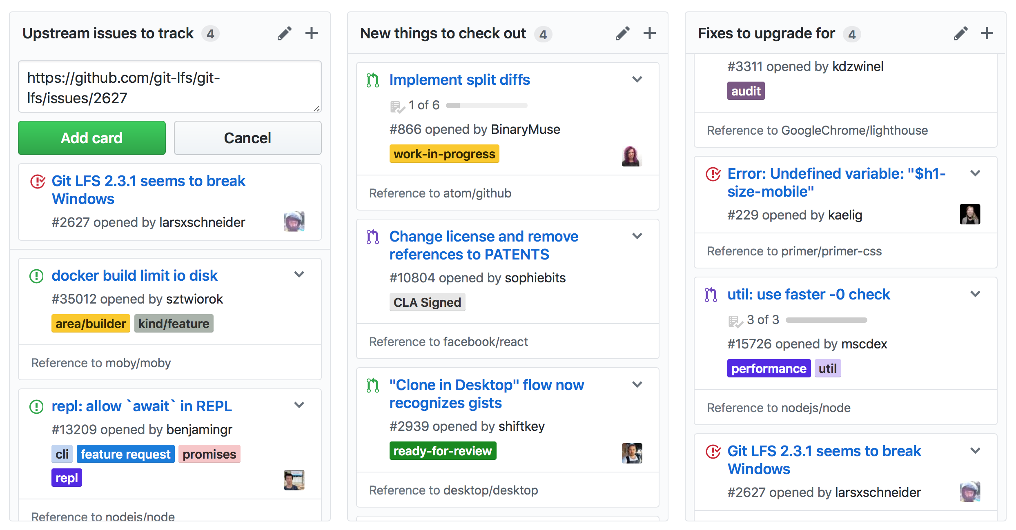
Projects
Organizational boards with Kanban methodology in mind
Allows you to create “comprehensive roadmaps” and checklists for features and bug fixes

Slide 24
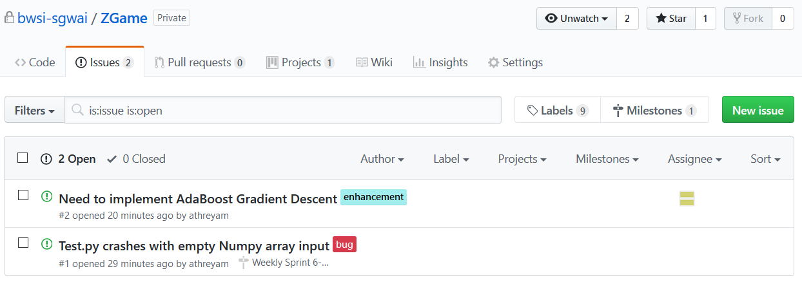
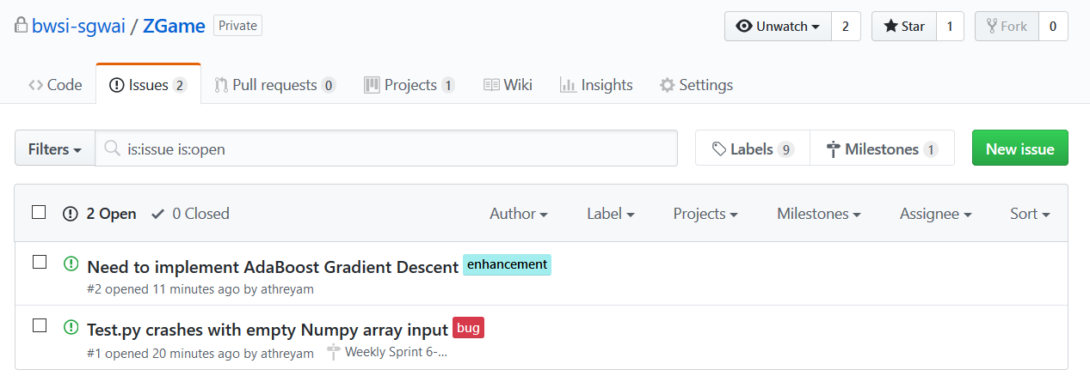
Better Organization, All in One
Issue
Label
Assignee
Milestone

Slide 25
GitHub is more than just commands!
Good practices with version control is critical in software projects
Git is a top-tier VCS tool
Project management is also important in any design project, especially one with time constraints and enthusiastic stakeholders
GitHub includes project management features to easily organize and plan during development

